Slide 1



Assignment 2: Non-Linear & Logistic Regression Analysis

Slide 2

Presented By :
Asma’a Fares 1210084
Khaled Rimawi 1210618

Slide 3
Agenda
1
Part 1 – Non-Linear Regression (Ridge & RBF)
  2
Part 2 – Logistic Regression for Churn
  3
  Model comparison & evaluation metrics
  4
  Conclusions and lessons learned

Slide 4
Part 1 – Non-Linear Regression
(Ridge & RBF)
1

Slide 5
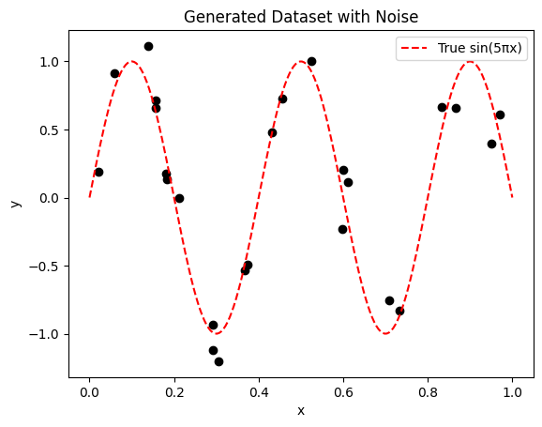
A.1) Ridge Regression - Synthetic Regression
we used Synthetic one-dimensional input x∈[0,1] , and the target “y” values come from non-linear function (sin(5πx)) + noise
Utilizing normal noise rather than uniform noise better represents realistic scenarios, as most noise tends to cluster around zero, with only a few extreme outliers present.

Slide 6
A.2) Polynomial Features & Ridge Regression
Original Feature and Expanded Features
  Original feature : x
  Expanded features : [1, x, x², …, xᵈ]
  Degree d = 10
Ridge Regression
Ridge regression aims to minimize the following objective:
  Loss = || y − Xw ||² + λ || w ||²
Where: λ (lambda) controls the strength of regularization.
Bias–Variance Trade-Off
  Small λ : Low bias , High variance , Model may overfit
  Large λ : High bias , Low variance , Model may underfit

Slide 7
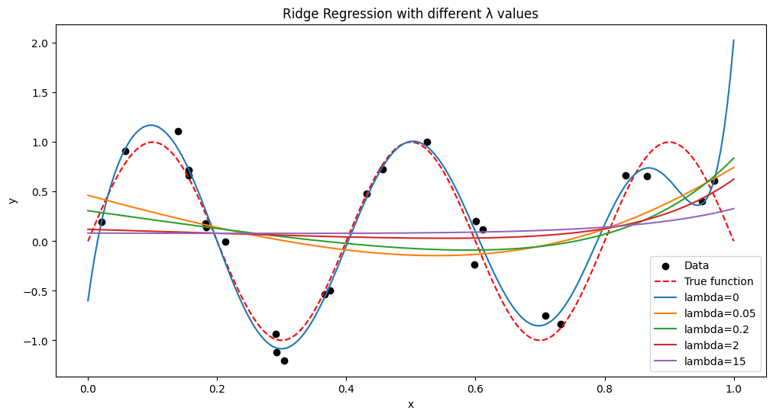
A.3) Ridge Regression with Multiple λ Values
λ = 0 or 0.05 → The curve follows all noisy points too closely → overfitting.
λ = 0.2 or 2 → The curve is smooth and still close to the real sine wave → seems best generalization.
λ = 15 → The curve is too flat, missing the sine shape → underfitting.

Slide 8
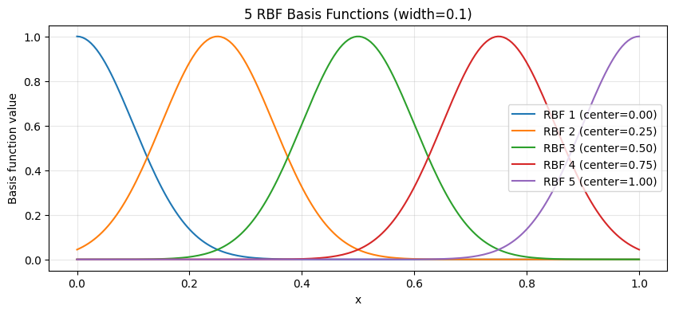

B) RBF (Radial Basis Function) Regression
  Radial Basis Function :
​
  Each curve is centered at a different α
  Width λ controls spread here (λ=0.1)

Slide 9
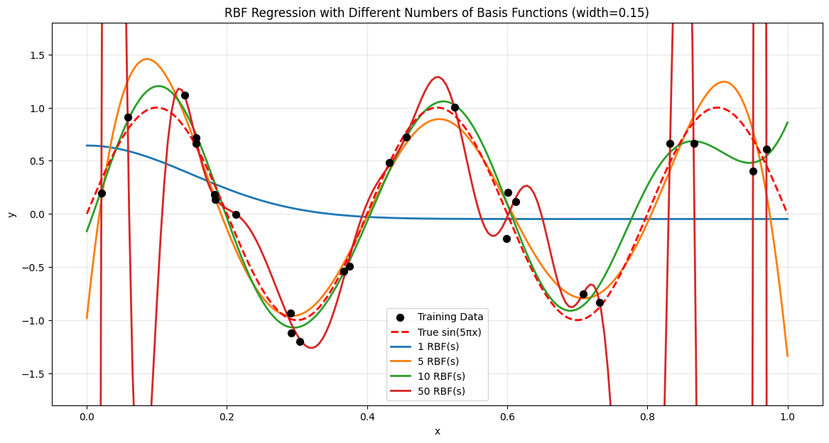

RBF with Different Numbers of Basis Functions
1 RBF: Too simple, underfits.
5 RBFs: Good balance, generalizes well.
10 RBFs: Captures details, moderate fit.
50 RBFs: Overfits, fits noise.
Conclusion: The configuration with 5
or 10 RBF basis functions provides the
best generalization performance

Slide 10
Part 2 – Logistic Regression for Churn
2

Slide 11
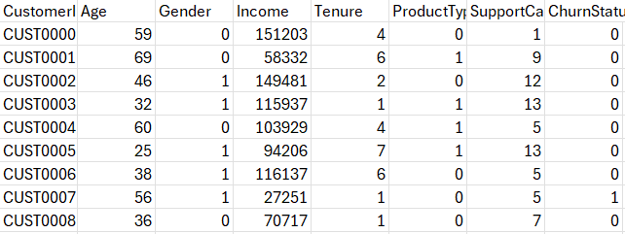
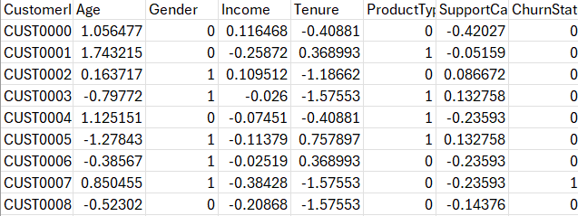
A) Data Preprocessing
1
Missing Value Handling
  Identify missing values in each column
  Implemented a thoughtful strategy:
    If missing values are less than 5% → Remove the affected rows
    If missing values range from 5% to 30% → Impute using median for numeric data and mode for categorical data
Data before Preprocessing
2
Outlier Detection (IQR Method)
  Detected outliers using Interquartile Range (IQR)
  Computes lower & upper bounds
Q1 − 1.5×IQR, Q3 + 1.5×IQR)
Data after Preprocessing

Slide 12
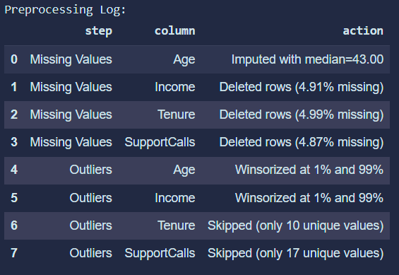
3
Outlier Handling
  Three Modes:
    Winsorization (default): Caps extreme values using the 1st and 99th percentiles.
    Remove: Eliminates rows containing outlier values.
    Keep: No action taken.
  Automatically bypasses low-cardinality columns (fewer than 20 unique values).
4
Feature Scaling
  Standardized numerical features using Z-score normalization
→ transforms data to mean = 0, standard deviation = 1.
Summary of Preprocessing Operations

Slide 13
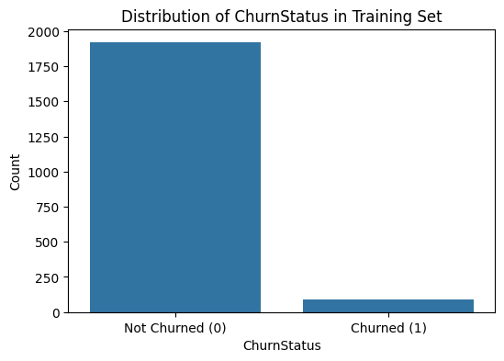

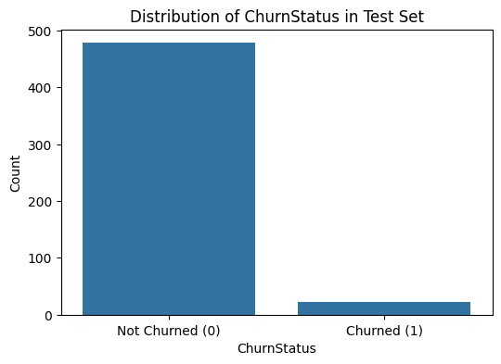
B) Class Distribution in Train ,Validation & Testing Sets
The dataset was split into 70% training, 15% validation, and 15% testing.
The class distributions shown above reveal a strong class imbalance across all splits, with the majority of customers belonging to the Not Churned (0) category.

Slide 14
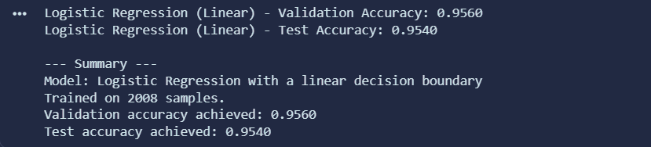
C.1) Training Logistic Regression with a linear decssion boundary
what we achieved from training logistic regression on linear decision boundary :

Slide 15
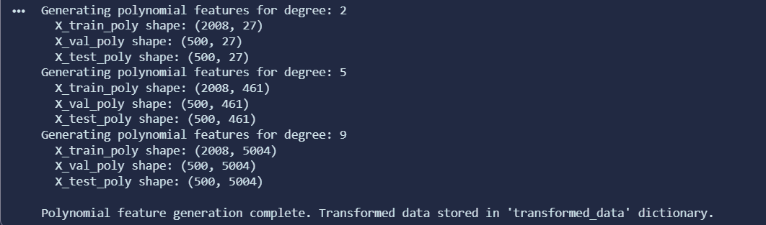
C.2) Logistic Regression with a non-linear decssion boundary using polynomial features
  For each degree (2, 5, and 9), the number of generated polynomial features grows significantly.
  Degree 2 → 27 features
  Degree 5 → 461 features
  Degree 9 → 5004 features

Slide 16
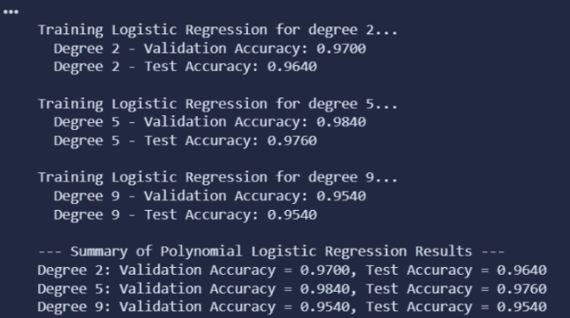
Cont... Validation & Test Accuracies vs Polynomial Degree
⭐ Overall Conclusion
  Degree 5 performs best overall.
  Degree 2 underfits; Degree 9 overfits.
The optimal trade-off between complexity and generalization is achieved at Degree 5.

Slide 17
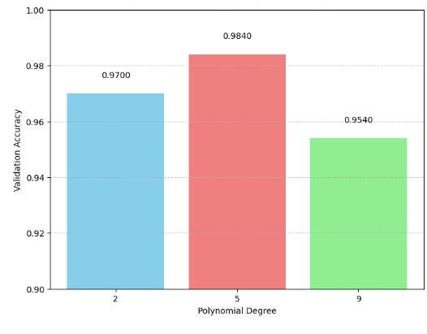

Validation Accuracy vs. Polynomial Degree

Slide 18
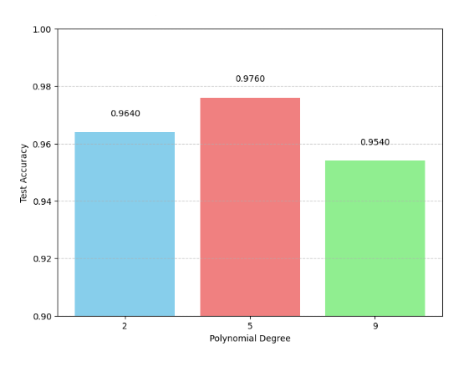
Test Accuracy vs. Polynomial Degree

Slide 19
Model comparison & evaluation metrics
3

Slide 20
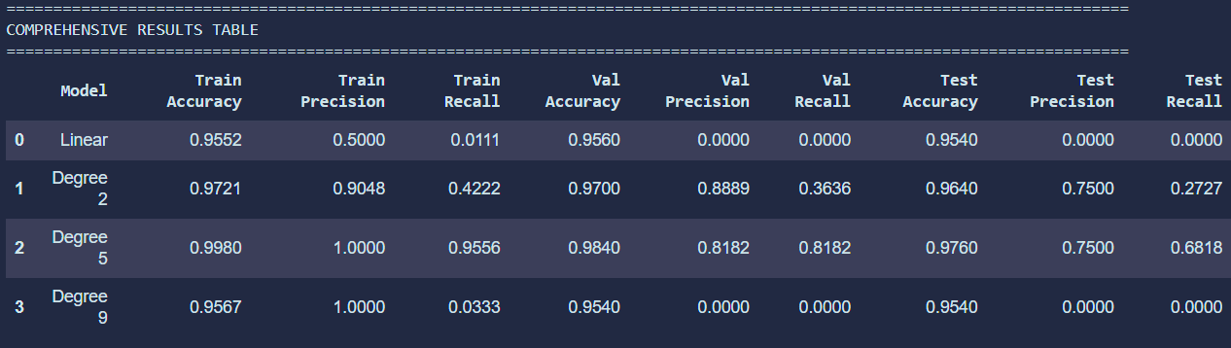
D) Comprehensive Model Evaluation with Accuracy, Precision, and Recall
D.1) Comprehensive Results Table

Slide 21
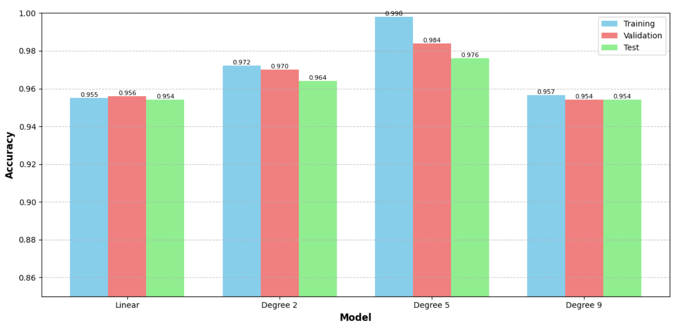
D.2) Training, Validation & Test Accuracy for Linear and Polynomial Models

Slide 22

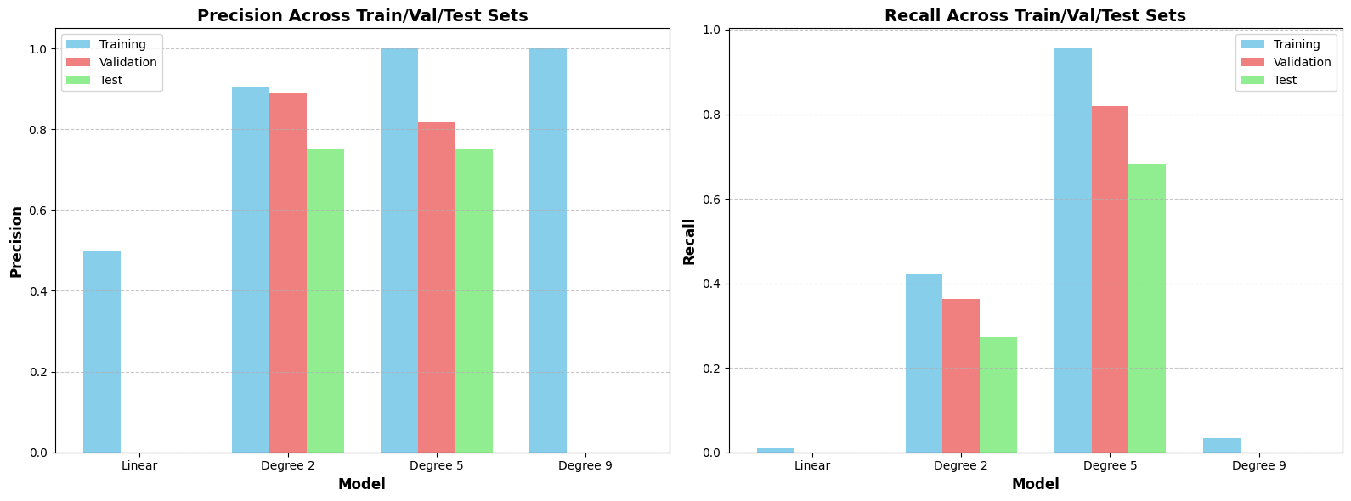
D.3) Precision and Recall Across Train, Validation, and Test Sets

Slide 23
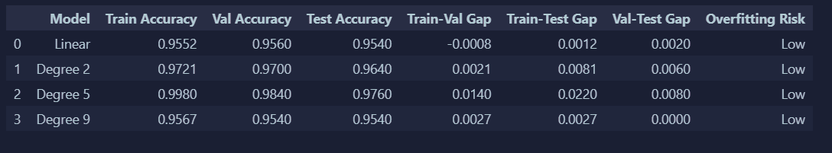
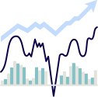
D.4) Model Stability and Overfitting Analysis
⭐ Overall Conclusion
Degree 5 provides the best balance between accuracy and generalization.
Increasing complexity beyond degree 5 (e.g., degree 9) does not improve performance and brings diminishing returns.

Slide 24
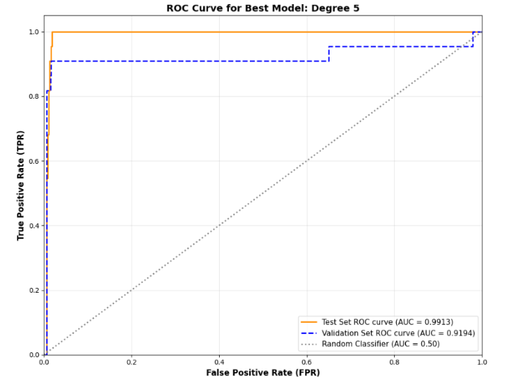
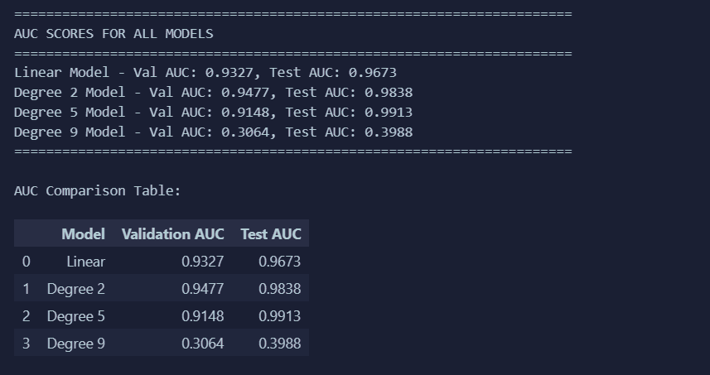
D.5) Best Model Selection and ROC Curve Analysis

Slide 25
Conclusions and lessons learned
4

Slide 26

1
3
The power of non-linear modeling
The balance between underfitting
and overfitting
  Polynomial and RBF features showed how increasing model flexibility can dramatically change predictions.
  But flexibility must be controlled Ridge regularization and careful feature selection are essential.
  Degree 2 → too simple
  Degree 9 → too complex
  Degree 5 → the “sweet spot” of complexity, yielding the best validation & test performance.
2
The importance of proper
preprocessing
4
The balance between underfitting
and overfitting
  Handling missing values, outliers, and feature scaling had a direct impact on model stability and accuracy.
  Clean data → better learning → stronger generalization.
With an imbalanced churn dataset, metrics like precision, recall, and AUC were crucial to fully understand model performance.

Slide 27

Thank You

